Slide 1
Introduction to Bioinformatics
Code: BIO-310
Multiple Sequence Alignment
Dr. Muhammad Tahir
Assistant Professor
COMSATS University Islamabad,
Attock Campus

Slide 2
Multiple Sequence Alignment (MSA)
Alignment of more than two DNA or Protein sequences of similar length.
A natural extension of pairwise alignment is multiple sequence alignment.
The dynamic programming algorithm used for optimal alignment of pairs of sequences can be extended to three sequences, but for more than three sequences, only a small number of relatively short sequences may be analyzed.

Slide 3
Uses of MSA
Helps in identification of conserved regions in the sequences.
An important step for phylogenetic analysis.
Useful in designing experiments to test and modify the function of specific proteins and also in predicting the function and structure of proteins, and in identifying new members of protein families.

Slide 4
Motivation
Multiple sequence alignments are used for many reasons, including:
To detect regions of variability or conservation in a family of proteins
To provide stronger evidence than pairwise similarity for structural and functional inferences
First step in:
  Phylogenetic reconstruction
  RNA secondary structure prediction
  Building profiles (probabilistic models) for protein families or DNA signals.

Slide 5
Global Multiple Sequence Alignment
Ex: MSA of 4 sequences
MQPILLLV, MLRLL, MKILLL, and MPPVLILV:
  MQPILLLV
  MLR—LL--
  MK-ILLL-
  MPPVLILV
No column is all gaps

Slide 6
Sum-of-pairs (SP) Measure
Each column is scored by summing the scores of all pairs of symbols in that column.
• E.g.,
match = 1, a mismatch = -1, gap = -2
I
- = score(I,-) + score(I, I) +score(I,V) + score(-,I) + score (-,V) + score(I,V)
I
= -2 + 1 + -1 + -2 + -2 + -1 = -7
V

Slide 7
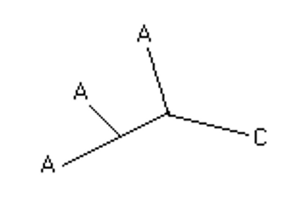
Is SP a good measure?
• column in alignment : A,A,A,C
• SP score = 1+1-1+1-1-1=0
• But maybe evolutionary history described by:
single C A mutation can explain the data, and thus Sum of Pairs (SP) tends to overcount mutations

Slide 8
An example of Multiple Alignment
VTISCTGSSSNIGAG-NHVKWYQQLPG
VTISCTGTSSNIGS--ITVNWYQQLPG
LRLSCSSSGFIFSS--YAMYWVRQAPG
LSLTCTVSGTSFDD--YYSTWVRQPPG
PEVTCVVVDVSHEDPQVKFNWYVDG--
ATLVCLISDFYPGA--VTVAWKADS--
AALGCLVKDYFPEP--VTVSWNSG---
VSLTCLVKGFYPSD--IAVEWWSNG--

Slide 9
Progressive Algorithm
Possible number of pairs is calculated first.
Pair-wise alignment is done.
Based on the scores, distance is calculated.
Guide tree is built.
Based on the guide tree, alignment is done again.

Slide 10
Multiple Alignment Method
The most practical and widely used method in multiple sequence alignment is the hierarchical extensions of pairwise alignment methods.
The principal is that multiple alignments is achieved by successive application of pairwise methods.

Slide 11
Multiple Alignment Method
The steps are summarized as follows:
  Compare all sequences pairwise.
  Perform cluster analysis on the pairwise data to generate a hierarchy for alignment. This may be in the form of a binary tree or a simple ordering
  Build the multiple alignment by first aligning the most similar pair of sequences, then the next most similar pair and so on. Once an alignment of two sequences has been made, then this is fixed. Thus for a set of sequences A, B, C, D having aligned A with C and B with D the alignment of A, B, C, D is obtained by comparing the alignments of A and C with that of B and D using averaged scores at each aligned position.

Slide 12
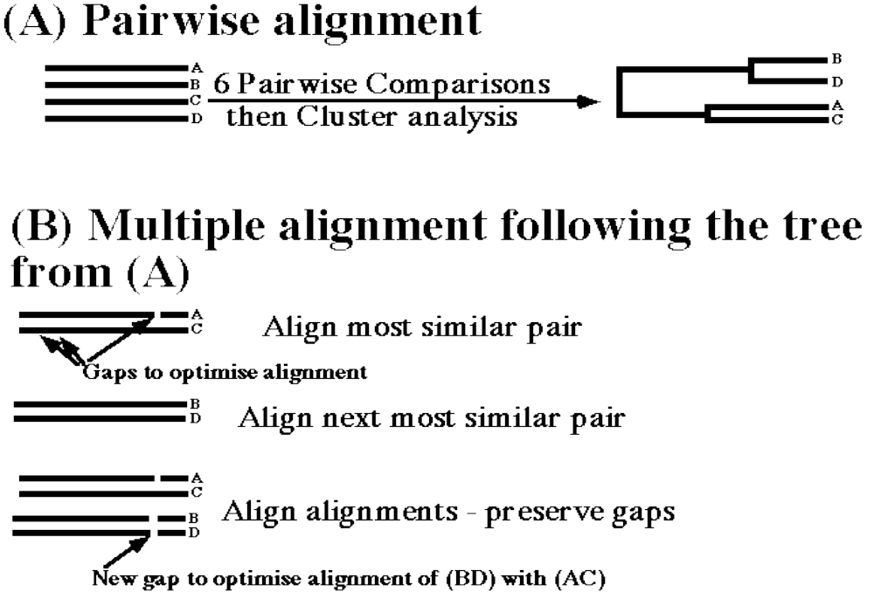
Steps in Multiple Alignment

Slide 13
Choosing sequences for alignment
General considerations
The more sequences to align the better.
Don’t include similar (>80%) sequences.
Sub-groups should be pre-aligned separately, and one member of each subgroup should be included in the final multiple alignment.

Slide 14
Multiple alignment in GCG
The program available in GCG for multiple alignment is Pileup.
The input file for Pileup is a list of sequence file_names or sequence codes in the database, created by a text editor.
Pileup creates a multiple sequence alignment from a group of related sequences using progressive, pairwise alignments. It can also plot a tree showing the clustering relationships used to create the alignment.
Please note that there is no one absolute alignment, even for a limited number of sequences.

Slide 15
Choosing sequences for PileUp
As far as possible, try to align sequences of similar length.
Pileup can align sequences of up to 5000 residues, with 2000 gaps (total 7000 characters).
Pileup is a good program only for similar (close) sequences.

Slide 16
Output of Pileup
!!NA_MULTIPLE_ALIGNMENT 1.0
PileUp of: @tnf.list
Symbol comparison table: GenRunData:pileupdna.cmp CompCheck: 6876
GapWeight: 5
GapLengthWeight: 1
tnf.msf MSF: 1706 Type: N August 12, 1997 08:10 Check: 5044 ..
Name: OATNFA1 Len: 1706 Check: 5831 Weight: 1.00
Name: OATNFAR Len: 1706 Check: 7533 Weight: 1.00
Name: BSPTNFA Len: 1706 Check: 1732 Weight: 1.00
Name: CEU14683 Len: 1706 Check: 6670 Weight: 1.00
Name: HSTNFR Len: 1706 Check: 191 Weight: 1.00
Name: SYNTNFTRP Len: 1706 Check: 3706 Weight: 1.00
Name: CATTNFAA Len: 1706 Check: 7430 Weight: 1.00
Name: CFTNFA Len: 1706 Check: 2566 Weight: 1.00
Name: RABTNFM Len: 1706 Check: 5089 Weight: 1.00
Name: RNTNFAA Len: 1706 Check: 4296 Weight: 1.00

Slide 17
Output of Pileup
//
1
OATNFA1 ~~~~~~~~~~ ~~~~~~~~~~ ~GGCCAAGAG
OATNFAR ~~~~~GGGAC ACCAGGGGAC CAGCCAAGAG
BSPTNFA ~~~~~~~~~~ ~~~~~~~~~~ ~~~~~~~~~~
CEU14683 ~~~~~~~~~~ ~~~~~~~~~~ ~~~~~~~~~~
HSTNFR ~~~~~~~~~~ ~~~~~~~~~~ ~~~~~GCAGA
SYNTNFTRP AGCAGACGCT CCCTCAGCAA GGACAGCAGA
CATTNFAA ~~~~~~~~~~ ~~~~~~~~~~ ~~~~~~~~~~
CFTNFA ~~~~~~~~~~ ~~~~~~~~~~ ~~~~~~~~~~
RABTNFM ~~~~AAGCTC CCTCAGTGAG GACACGGGCA
RNTNFAA ~~~~~~~~~~ ~~~~~~~~~~ ~~~~~~~~~~

Slide 18
Output of Pileup
401
OATNFA1 TTCAG..... .ACACTCAGG TCATCTTCTC AAGC
OATNFAR TTCAG..... .ACACTCAGG TCATCTTCTC AAGC
BSPTNFA TTCAA..... .ACACTCAGG TCCTCTTCTC AAGC
CEU14683 TTCAG..... .ACCCTCAGG TCATCTTCTC AAGC
HSTNFR CCCAG..... .GCAGTCAGA TCATCTTCTC GAAC
SYNTNFTRP CCCAG..... .GCAGTCAGA TCATCTTCTC GAAC
CATTNFAA CCCAG..... .ACACTCAGA TCATCTTCTC GAAC
CFTNFA TCCAG..... .ACAGTCAAA TCATCTTCTC GAAC
RABTNFM CCCAGATGGT CACCCTCAGA TCAGCTTCTC GGGC
RNTNFAA CCCAGACCCT CACACTCAGA TCATCTTCTC AAAA

Slide 19
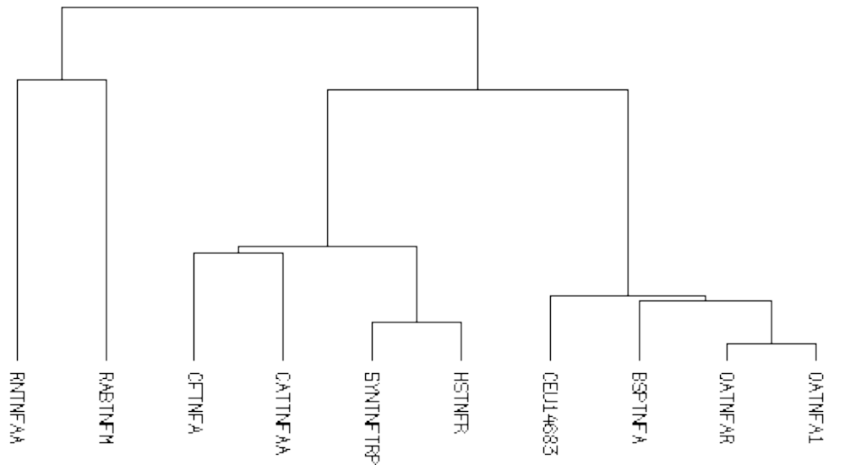
Output of Pileup

Slide 20
PileUp considirations
PileUp does global multiple alignment, and therefore is good for a group of similar sequences.
PileUp will fail to find the best local region of similarity (such as a shared motif) among distant related sequences.
PileUp always aligns all of the sequences you specified in the input file, even if they are not related. The alignment can be degraded if some of the sequences are only distantly related.

Slide 21
Pileup special options
Creating an end-weighted alignment:
  ENDWeight
Realigning part of an existing alignment:
  INSitu -Begin=XX -END=YYwhere XX and YY specify the exact positions to begin (XX) and end (YY) the re-alignment.

Slide 22
Displaying a multiple alignment in GCG
There are several programs to display the multiple alignment prettily.
The Pretty program prints sequences with their columns aligned and can display a consensus for the alignment, allowing you to look at relationships among the sequences.
The PrettyBox program displays the alignment graphically with the conserved regions of the alignment as shaded boxes. The output is in Postscript format.

Slide 23
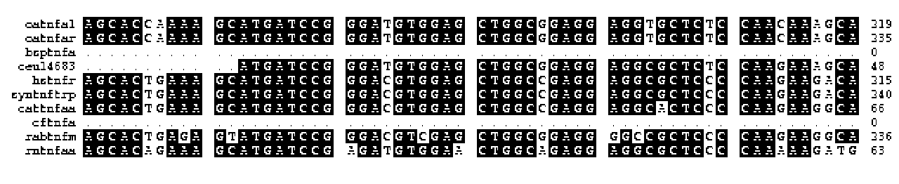
Example of PrettyBox Output

Slide 24
ShadyBox
ShadyBox is a multiple alignment editor program which enables you to box and shade residues or segments of multiple aligned sequences.
ShadyBox will work on a msf or pretty output file and will produce a postscript output file. The original input file is not changed.
ShadyBox enables you to save your work in the middle, exit the program, and resume at a later stage.

Slide 25
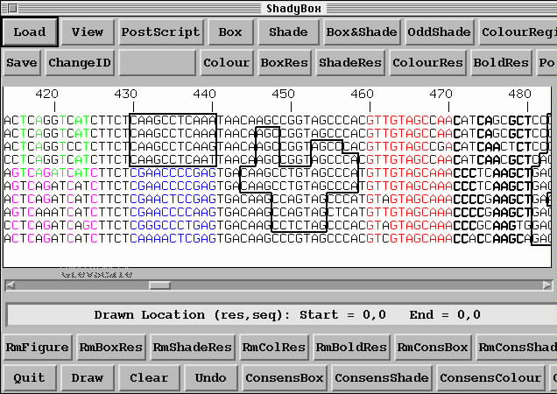
ShadyBox Output

Slide 26
Blocks database and tools
Blocks are multiply aligned ungapped segments corresponding to the most highly conserved regions of proteins.
The Blocks web server tools are :
  Block Searcher
  Get Blocks
  Block Maker
These are aids to detection and verification of protein sequence homology.
They compare a protein or DNA sequence to a database of protein blocks, retrieve blocks, and create new blocks, respectively.

Slide 27
The BLOCKS web server
The BLOCKS WWW server can be used to create blocks of a group of sequences, or to compare a protein sequence to a database of blocks.
The Blocks Searcher tool should be used for multiple alignment of distantly related protein sequences.

Slide 28
The Blocks Searcher tool
For searching a database of blocks, the first position of the sequence is aligned with the first position of the first block, and a score for that amino acid is obtained from the profile column corresponding to that position.
Scores are summed over the width of the alignment, and then the block is aligned with the next position.
This procedure is carried out exhaustively for all positions of the sequence for all blocks in the database, and the best alignments between a sequence and entries in the BLOCKS database are noted.
If a particular block scores highly, it is possible that the sequence is related to the group of sequences the block represents.

Slide 29
The Blocks Searcher tool
Typically, a group of proteins has more than one region in common and their relationship is represented as a series of blocks separated by unaligned regions.
If a second block for a group also scores highly in the search, the evidence that the sequence is related to the group is strengthened and is further strengthened if a third block also scores it highly, and so on.

Slide 30
The BLOCKS Database
The blocks for the BLOCKS database are made automatically by looking for the most highly conserved regions in groups of proteins represented in the PROSITE database.
These blocks are then calibrated against the SWISS-PROT database to obtain a measure of the chance distribution of matches.
It is these calibrated blocks that make up the BLOCKS database.

Slide 31
The Block Maker Tool
Block Maker finds conserved blocks in a group of two or more unaligned protein sequences, which are assumed to be related, using two different algorithms.
Input file must contain at least 2 sequences.
Input sequences must be in FastA format.
Results are returned by e-mail.

